Slide 1
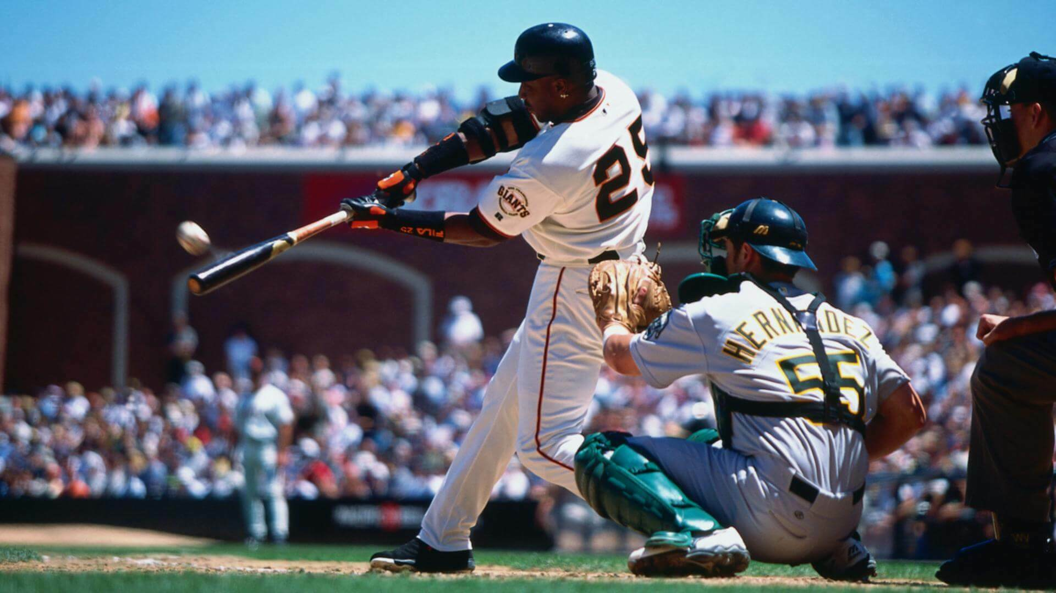
Using machine learning on MLB statistics
Nov 21, 2024
Matthew Cavanaugh
IOD Project 2

Slide 2

Data source and background
https://www.baseball-reference.com/leagues/majors/2024-standard-batting.shtml
Baseball Reference contains detailed statistics on all levels of professional and college baseball stretching as far back as 1871 (full play-by-play data on all MLB games since 1952).
(Parent company Sports Reference also operates Basketball Reference, Pro Football Reference, and many others)
I chose to use baseball batting data, as all players are attempting to do the same thing regardless of defensive position, unlike other sports where differing roles may unfairly inflate certain metrics.

Slide 3
Data cleaning
Dataset was relatively clean to begin with, however, you do have to be careful in how you sort data when creating the CSV, or it will break up data of players who played for multiple teams.
There were a handful of nulls as a result of some players not having enough plate appearances to calculate certain metrics. I filled these with 0.
I had to create a binary All-Star column to use as the target, extracting from an existing “Awards” column.

Slide 4
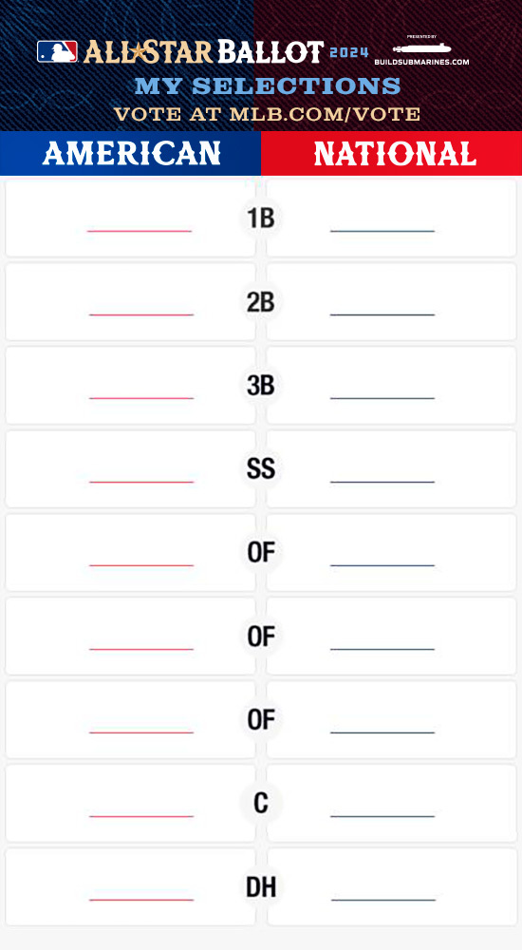
Data limitations
The All-Star Game takes place in mid-July, while the regular season lasts through the end of September. As a result, a player whose performance dips after July, or who is injured and misses games, may have misleadingly poor full-season stats despite a strong start.
Additionally, this dataset does not include defensive statistics, which also influence voters’ decisions. I excluded those statistics here as some players are exclusively Designated Hitters and do not play defense.
Finally, All-Star selection is not necessarily based on statistics. Starters are chosen via a fan vote. Reserves (bench players) are then selected from a player ballot and by the Commissioner’s Office. Thus, there is some level of subjectivity in the process, and a bias may exist toward players from more popular teams.

Slide 5
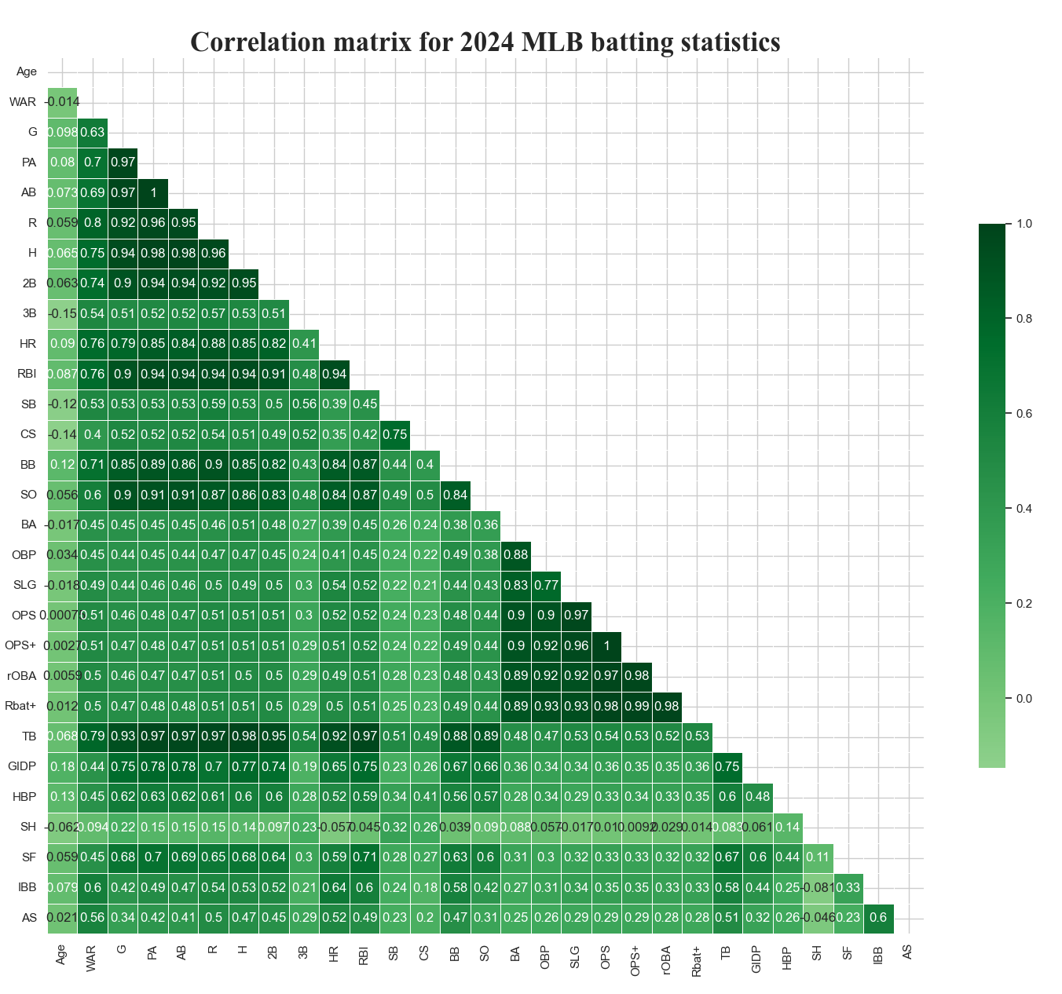
Correlation
heatmap

Slide 6
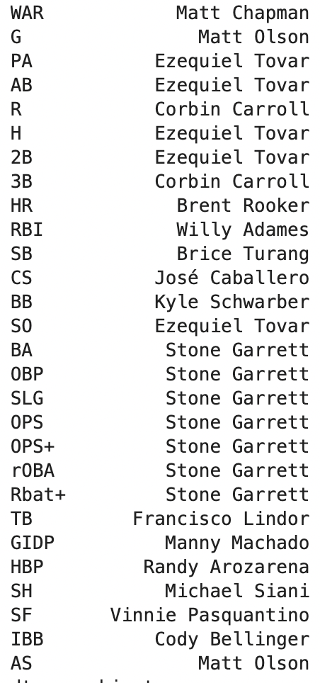
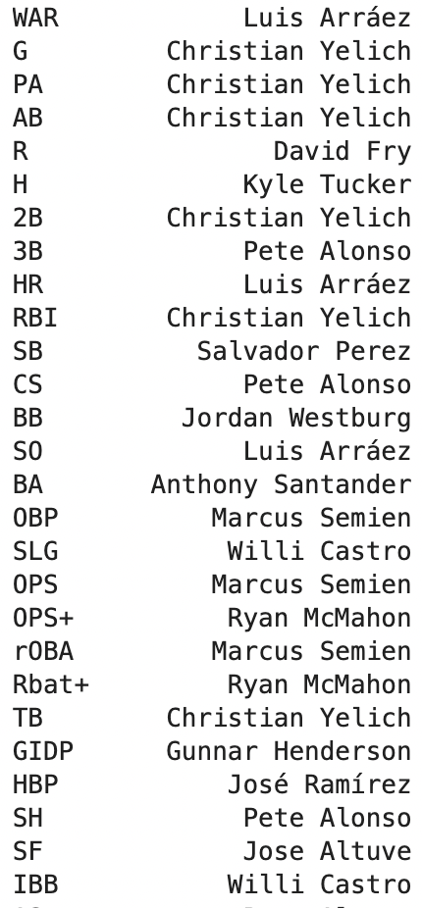
Worst snubs? Least deserving players?
Left: The non All-Star player with the best result in each stat.
Right: The All-Star player with the worst result in each stat.

Slide 7
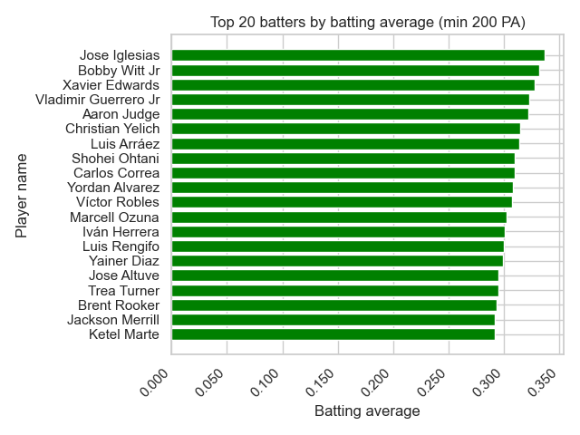
Batting average leaders

Slide 8
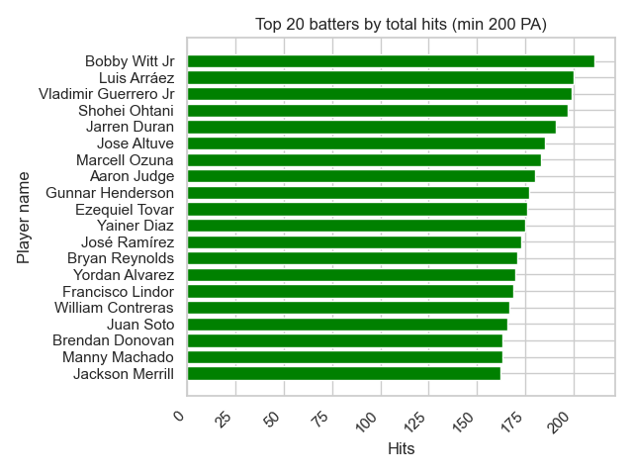
Hit leaders

Slide 9
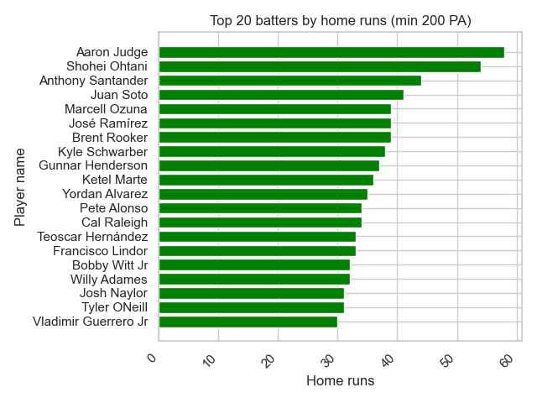
Home run leaders

Slide 10
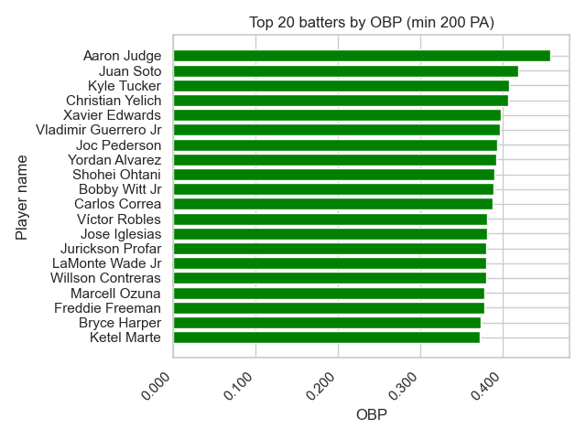
OBP (on base percentage) leaders

Slide 11
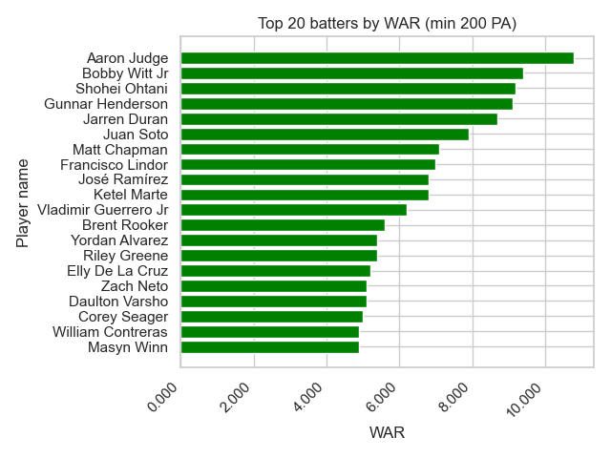
WAR (wins above replacement) leaders

Slide 12

Model 1: Logistic Regression
Objective: Using 28 statistics on all 651 players who had a plate appearance in the 2024 Major League Baseball season, test the accuracy of a logistic regression model in determining whether each player made the All-Star team.
Note - The first time through I had a weird problem with my code where 0s and 1s were reversed. I made every effort to double check everything, but this may affect the calculation of some statistics.
“Hey now…”

Slide 13
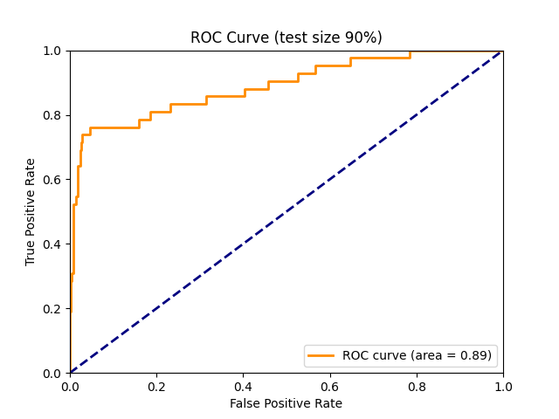
Logistic Regression - Test size 90%
Training results and metrics
Training score: 100%
Test score: 97.270
Intercept: -2.02217
True positives: 26
True negatives: 534
False positives: 10
False negatives: 16
Accuracy: 95.563%
Precision: 72.222%
Recall: 61.905%

Slide 14
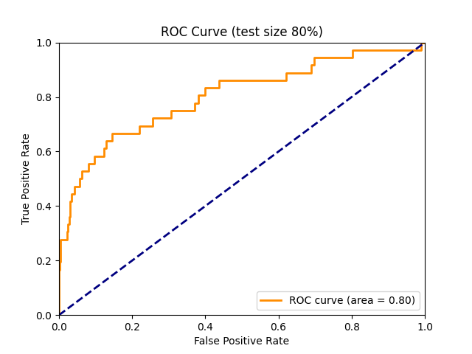
Logistic Regression - Test size 80%
Training results and metrics
Training score: 100%
Test score: 97.121%
Intercept: -0.32978
True positives: 12
True negatives: 472
False positives: 13
False negatives: 24
Accuracy: 92.898%
Precision: 48.0%
Recall: 33.333%

Slide 15
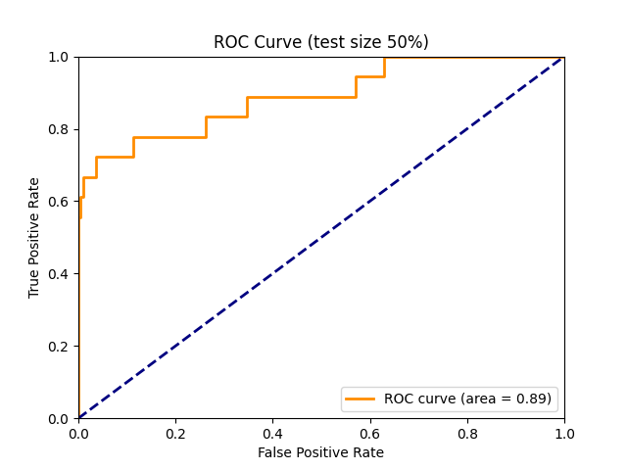
Logistic Regression - Test size 50%
Training results and metrics
Training score: 96.307%
Test score: 97.546
Intercept: -1.10895
True positives: 12
True negatives: 303
False positives: 5
False negatives: 6
Accuracy: 96.626%
Precision: 70.882%
Recall: 66.666%

Slide 16
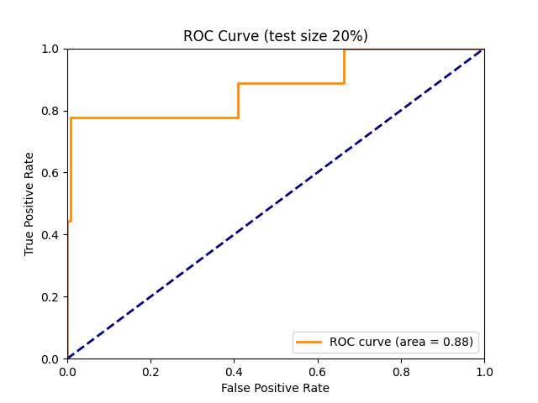
Logistic Regression - Test size 20%
Training results and metrics
Training score: 96.538%
Test score: 96.183%
Intercept: -0.41253
True positives: 6
True negatives: 121
False positives: 1
False negatives: 3
Accuracy: 96.947%
Precision: 85.714%
Recall: 66.666%

Slide 17
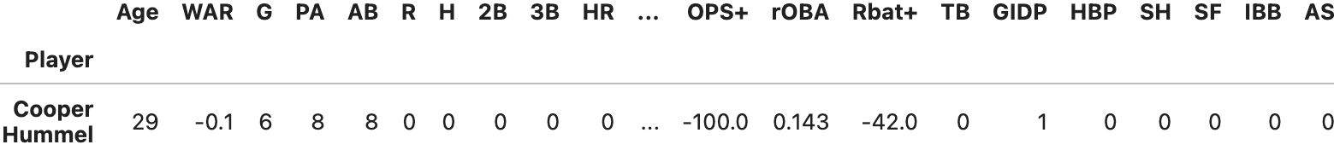
Logistic Regression
(Full dataset)
Score: 97.388%
Intercept: -0.93409333
True positives: 36
True negatives: 598
False positives: 7
False negatives: 10
False positives and false negatives mostly looked reasonable, except for this false positive:

Slide 18

Model 2: K-Nearest Neighbors (KNN)
Objective: Using 28 statistics on all 651 players who had a plate appearance in the 2024 Major League Baseball season, test the accuracy of a KNN model in determining whether each player made the All-Star team.
(Same as with Logistic Regression)
(Insert whistle solo)

Slide 19
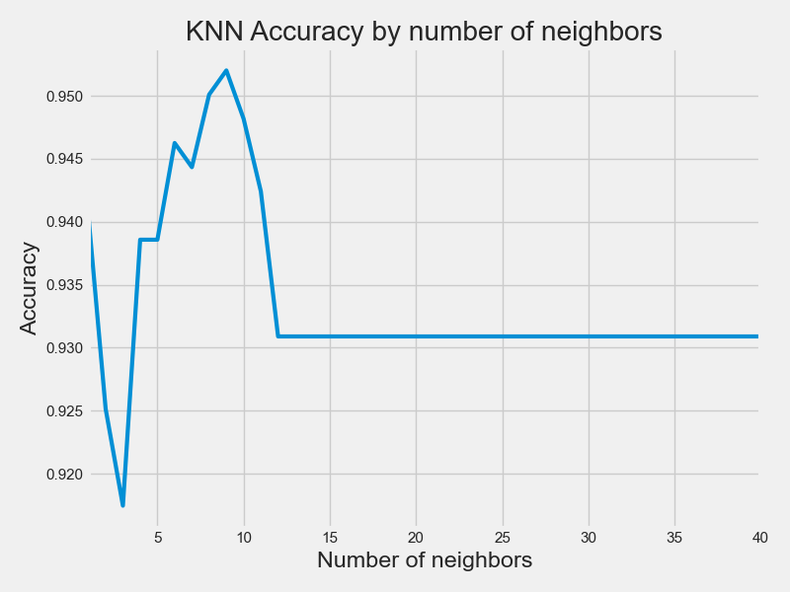
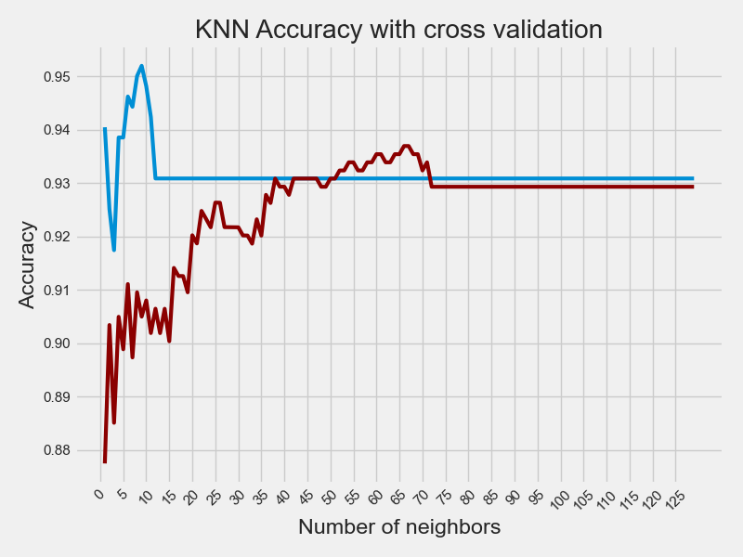
KNN: Finding the ideal n_neighbors
KNN accuracy plotted by number of neighbors. Accuracy peaks when n_neighbors = 9.
KNN accuracy by number of neighbors, cross validated with a standardized predictor matrix.

Slide 20
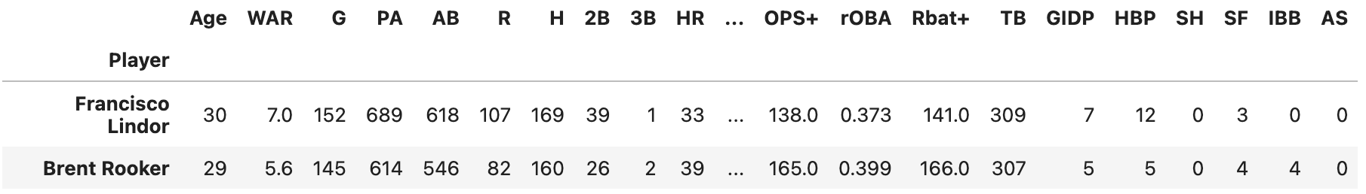
KNN: N_neighbors = 9 (test size 80%)
Training score: 94.615%
Test score: 95.969%
Model score: 96.160%
True positives: 20
True negatives: 603
False positives: 2
False negatives: 26
Accuracy: 95.69892%
Precision: 90.90909%
Recall: 43.47826%
Only two false negatives. Let’s see them.

Slide 21
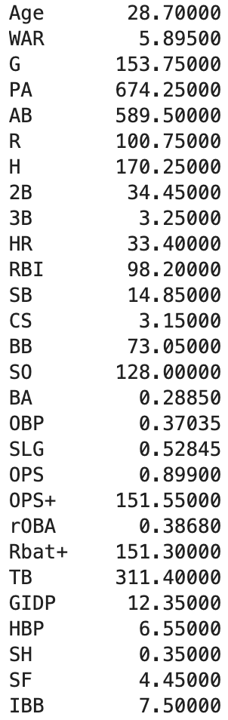
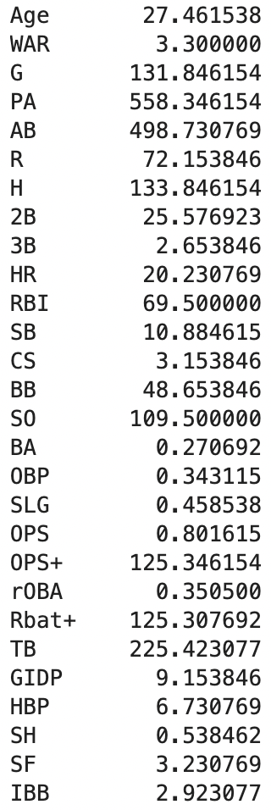
KNN: True positives & false negatives
Left:
Average statistics for every category among True Positives.
Right:
Average statistics for every category among False Negatives. These players performed well, but notably worse on most metrics than the True Positives. Are these the fan votes?

Slide 22
Model 3: DBScan
Objective:
Find the most representative-looking cluster plot between Home Runs and Batting Average.

Slide 23
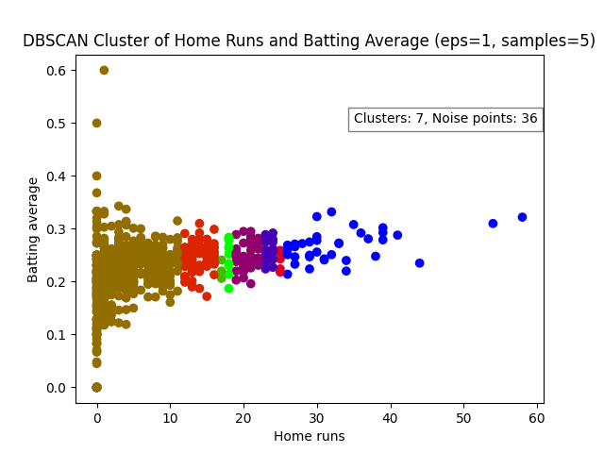
Model 3: DBSCAN
Epsilon=1, min_samples = 5
This is the one I landed on as the “best” after some testing. Even so, some of the clusters seem awkwardly small or excessively large.
But watch what happens when we change the parameters just a little bit.

Slide 24
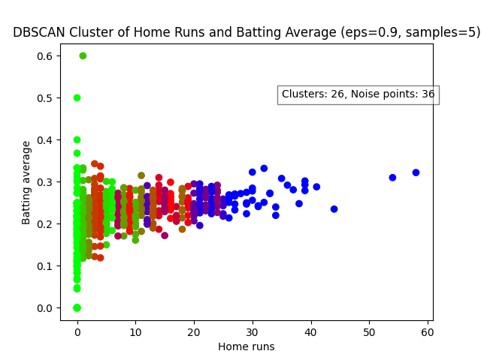
Model 3: DBSCAN
Epsilon=0.9, min_samples = 5
The noise points remain the same, but now there are 26 clusters, far too many to be useful.

Slide 25
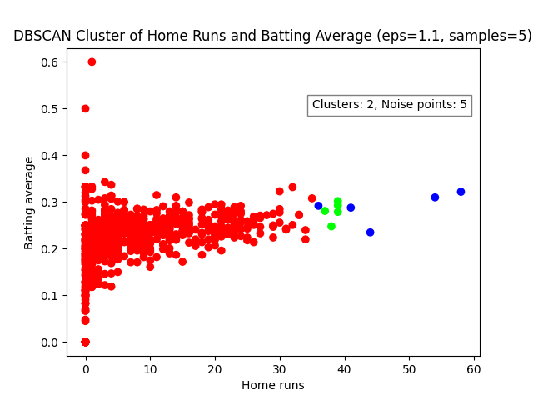
Model 3: DBSCAN
Epsilon=1.1, min_samples = 5
While this time we get rid of noise, we’re now down to just 2 clusters, which feels like too few to measure performance on a league-wide scale.

Slide 26
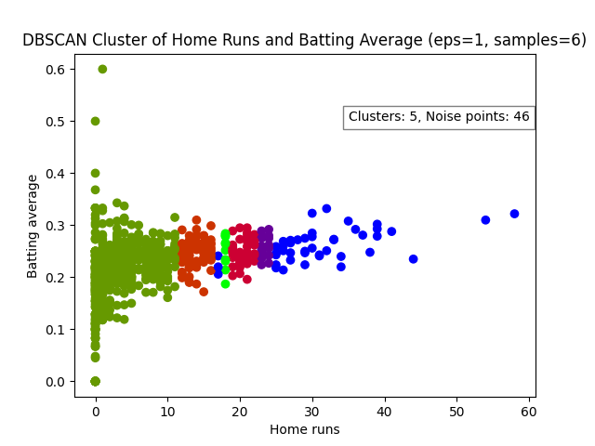
Model 3: DBSCAN
Epsilon=1, min_samples = 6
Putting epsilon back to 1 but minimum samples at 6, we have fewer clusters and more noise points. This is still probably worse than the first one we tried.

Slide 27
Final thoughts and observations
Overall, the Logistic Regression model performed well. However, certain scores seem to rise or fall inconsistently when the test size is changed. This may be an overfitting problem.
KNN had mostly good stats, but a bad recall - it was too aggressive in labeling players as non-All-Stars (26 of 46 were false negatives!)
DBSCAN is kind of awkward. It may simply be too sensitive to small changes to work in many contexts.
It could just be that my dataset is unbalanced.

